Slide 1
Snack Shack Survey Data Visualizations
AND INSIGHTS
By: Shaunelle Riley

Slide 2
Presentation Overview
This presentation will cover:
  Data visualizations
  Business Insights
The data utilized in this presentation was collected from surveys given to employees.

Slide 3
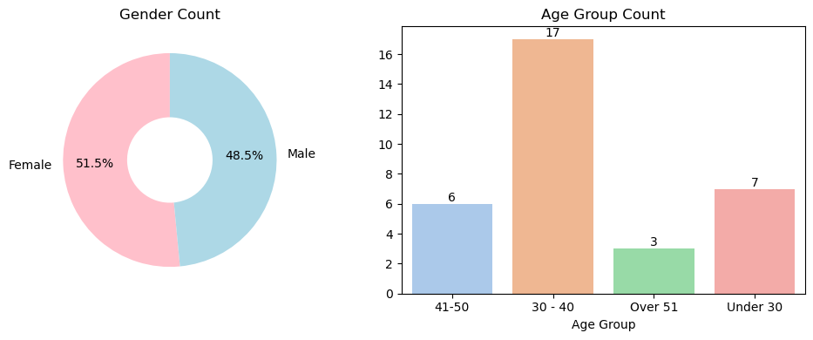
Demographic Information

Slide 4
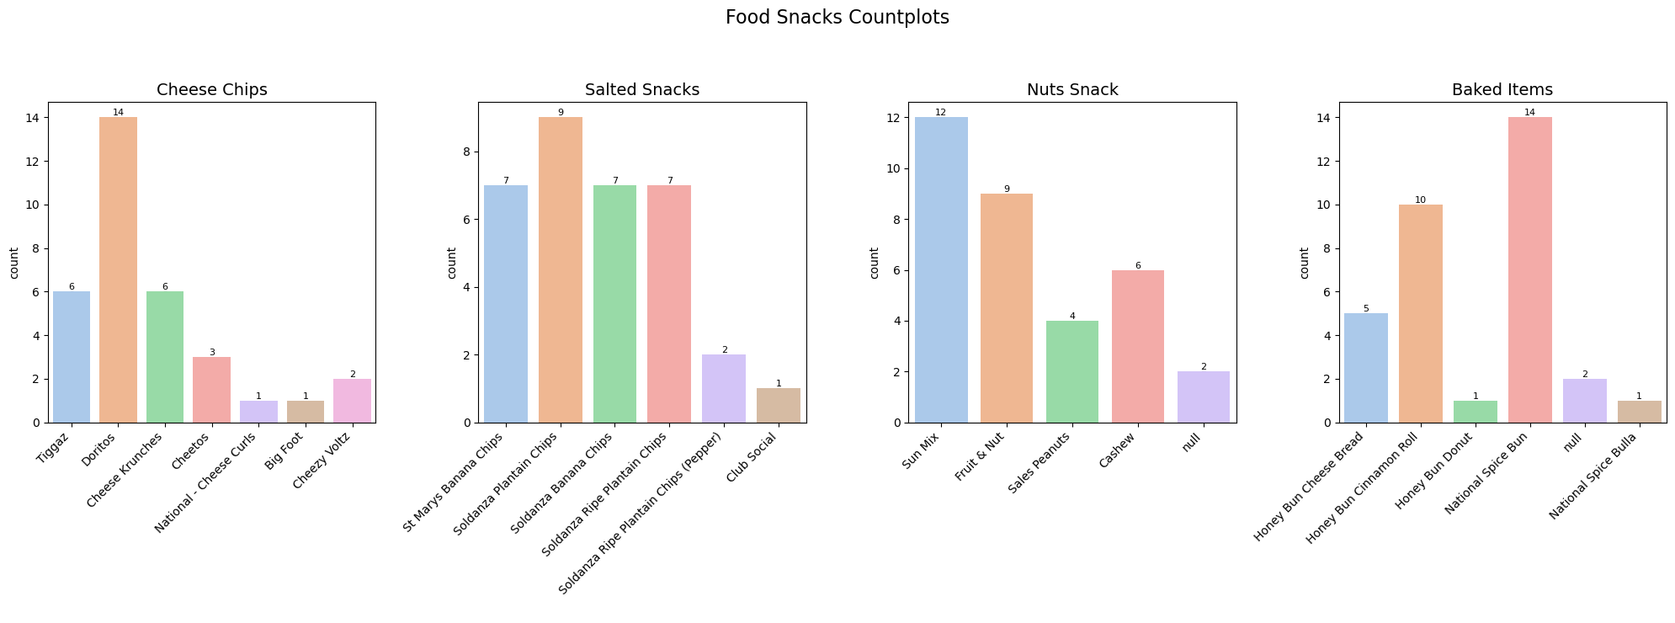
Food Snacks

Slide 5
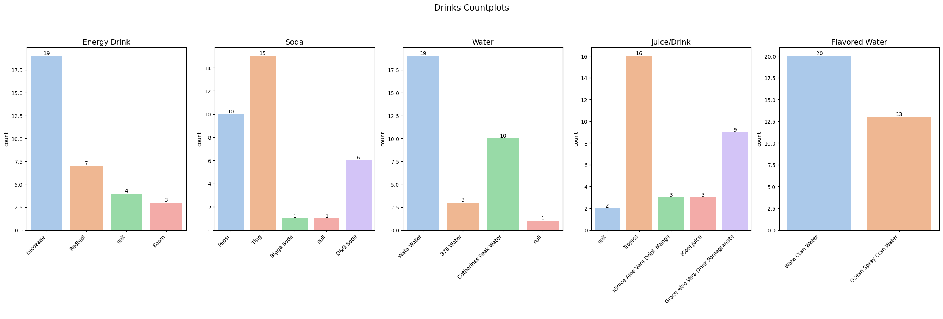
Drinks

Slide 6
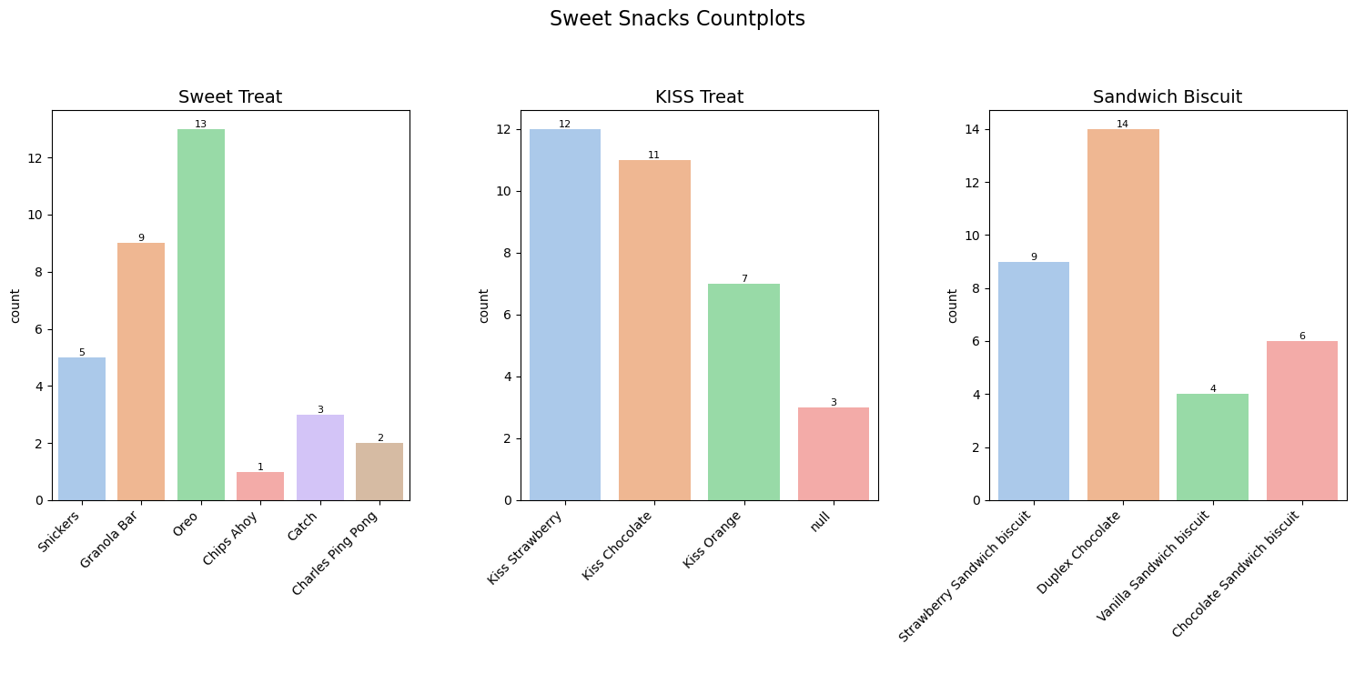
Sweet Snacks

Slide 7
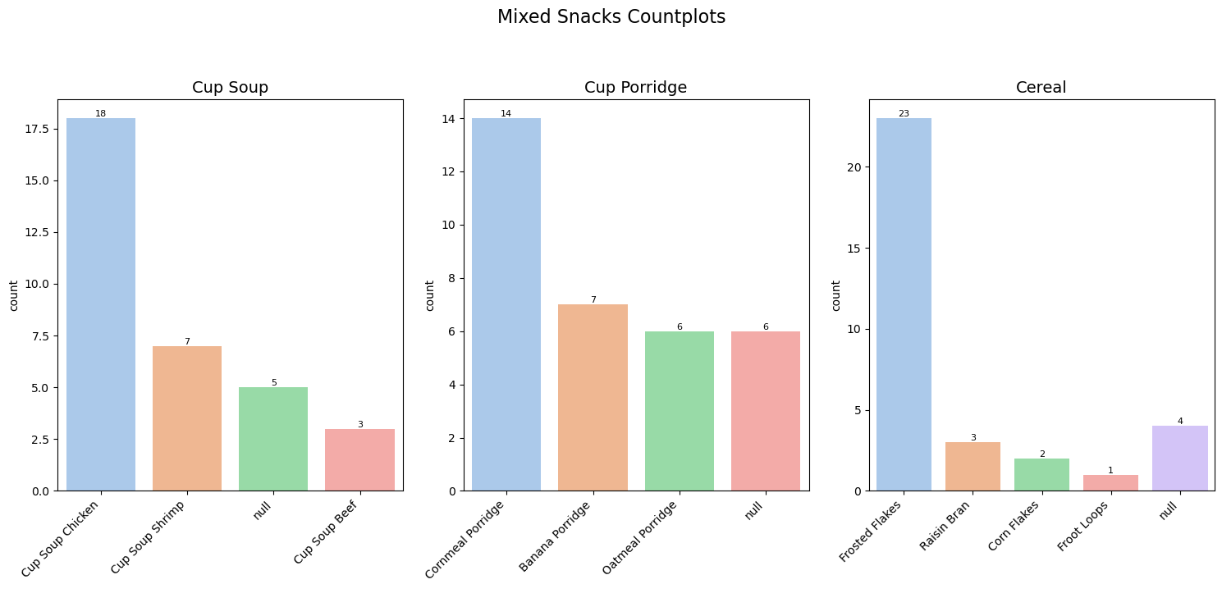
Mixed Snacks

Slide 8
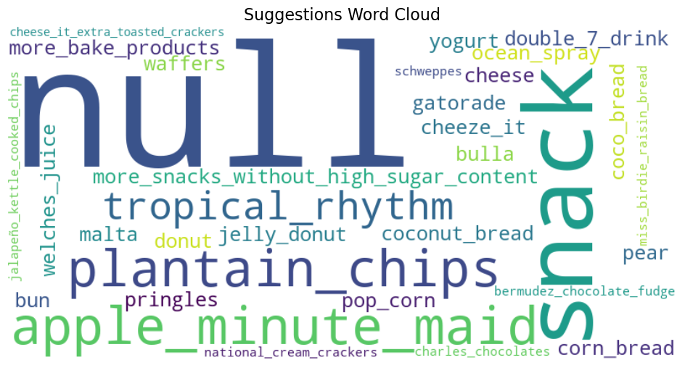
Suggestion Cloud

Slide 9
Business Insights
The analysis will address the following key areas:
  Assessment of survey data quality and effectiveness
  Identification of preferred and less preferred snack categories among respondents
  Suggestions

Slide 10
Assessment of survey data quality and effectiveness
The survey data was fully complete, with all respondents providing answers to every question.
This high level of response completeness strengthens the reliability of the analysis and ensures that the insights generated accurately reflect the preferences and needs of the individuals who will be using the snack shack.

Slide 11
Identification of preferred and less preferred snack categories among respondents
The survey results indicate that sweet treats, sandwich biscuits, flavored water, cheese chips, and salted snacks were the most preferred categories, with no respondents leaving these items unanswered. Across all categories, only mixed snacks had more than two null responses, highlighting a general consensus among respondents for quick and easy snack options.
Based on these insights, mixed snacks should represent a small portion of the total offerings. To optimize the selection while catering to demand:
  Offer at most the top two items within each major snack category, as these account for approximately 73% of all selections on average.
  For the mixed snack category, it is recommended to offer only the most preferred item, which accounts for approximately 55% of all selections on average.

Slide 12
Suggestions
Most respondents left the suggestion field blank, indicating that the options provided were satisfactory.
The few responses that were provided were extremely varied, and therefore it is recommended to continue offering the existing options.

